Slide 1

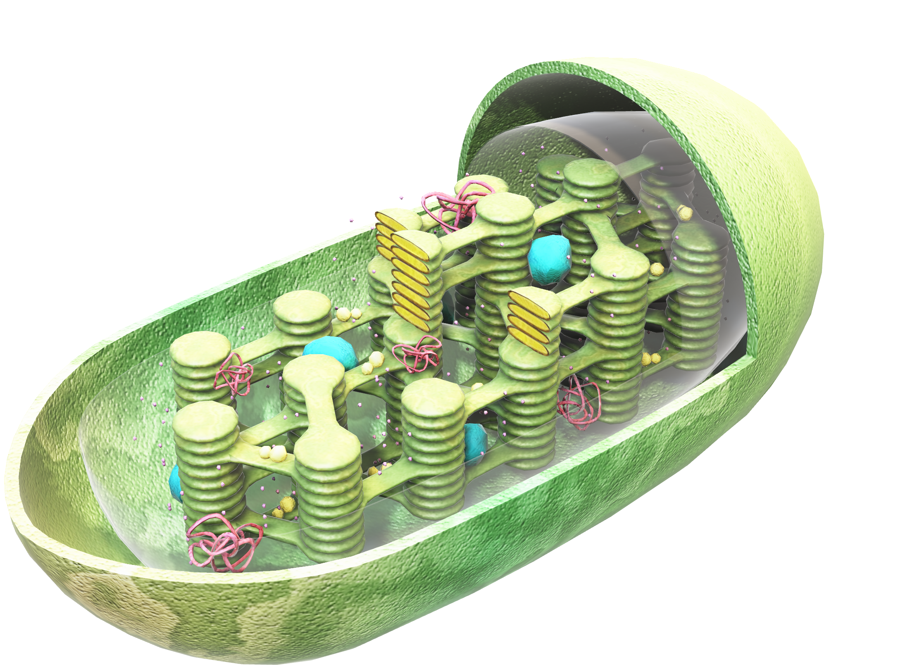
How DApps gain energy
Dapp will generate revenue by liquid staking Archway rewards and using benefits of restaking/autocompounding staking rewards offered by liquidity protocols, by using applications of liquid archway rewards tokens like lending,LPing, participating in airdrop revenue offered by liquidity protocols, using epoch middleware to maximise liquid staking strategy by staking maximum threshold Archway rewards, saving gas fees, claiming at maximum yield redemption rate.
Archway chain will generate revenue by taking certain fee from cumulative redemption amount of liquid tokens of Dapps.
Photosynthesis
Suhas Aggarwal
Suhas Aggarwal
Click on the model to interact

Slide 2
Advantage of epoch architecture
1)enableliquidstaking - to Enable liquid staking for contract/DApp
2)rewards_withdrawal - Contracts/Dapp will automatically be able to withdraw rewards from pool in periodic way
3)minimumrewardstoliquidstake - Dapps or contracts will be able to accumulate rewards and stake threshold reward amount periodically
4)Archway will be able to centrally liquid stake rewards of all Contracts/Dapps saving lot of gas fees.
5)Dapps will be able to autocompound their liquid stake via liquidity providers.
6)Dapps will be able to increase their liquidity via lending or LPing.
7)Dapps/contracts will be able to redeem their liquid tokens at maximum redemption rate periodically.
}
)

Slide 3


LIQUIDITY CONFIGURATION FOR EACH Dapp
// UpdateContractMetadataRequest is the Msg.UpdateMetadata request.
type UpdateContractMetadataRequest struct {
// OwnerAddress if not empty, changes the contract metadata ownership. OwnerAddress string `json:"owner_address"`
// RewardsAddress if not empty, changes the rewards distribution destination address. RewardsAddress string `json:"rewards_address"`
// LiquidTokensAddress if liquidity enabled otherwise empty, changes Liquid Tokens distribution destination
Address
LiquidityTokensAddress string `json:"liquidity_tokens_address"`
// RedemptionAddress if liquidity enabled otherwise empty, changes Redemption tokens distribution destination Address
Redemption Address string `json:"rewards_address"`
//Enable liquid staking for Dapp
EnableLiquidStaking bool `json:"enable_liquid_staking"`
//Minimum rewards amount to liquid stake
MinimumRewardstoLiquidStake sdk.Coins `json:" minimum_rewards_to_liquid_stake "`
//Liquid Stake Interval for rewards, after rewards aggregation LiquidStakeInterval uint64 `json:" liquid_stake_interval"`
//Redemption Interval for redeeming liquid tokens
RedemptionInterval uint64 `json:" redemption_interval"`
//Rewards Withdrawal Interval for Dapp rewards withdrawal from pool RewardsWithdrawalInterval uint64 `json:" rewards_withdrawal_interval"`
}
liquidstakedepositRecord := recordstypes.LiquidStakeDepositRecord{
LiquidStakeAmount: sdkmath.ZeroInt(), Denom: hostZone.HostDenom, HostZoneId: hostZone.ChainId,
Status: recordstypes.LiquidStakeDepositRecord_LIQUIDSTAKE_QUEUE, DepositEpochNumber: epochNumber,
}
k.RecordsKeeper.AppendLiquidStakeDepositRecord(ctx, liquidstakedepositRecord)

Slide 4
Here is a brief overview of architecture
In Archway code contract metadata is used to store Rewards Address for contract.
Certain additional fields -
1)enableliquidstaking - to enable liquid staking for contract,
2)Liquidity tokens address - address where contracts liquid tokens will be stored,
3)redemption address - redemption tokens distribution address,
4)minimumrewardstoliquidstake - minimum rewards amount to liquid stake,
5)liquid stake interval - Liquid Stake Interval for rewards, after rewards aggregation,
6)redemption interval - Redemption Interval for redeeming liquid tokens,
7)rewards_withdrawal_interval - Rewards Withdrawal Interval for Dapp rewards withdrawal from pool

Slide 5
Description of epoch module to optimise liquid staking on Archway
Epoch are just like cron or azkaban schedule for code to run.
There are different types of epoch intervals - Week, Day Epoch, LIQUID_STAKING_DApp_Rewards_EPOCH 12 hours app, REDEMPTION_RATE_QUERY_EPOCH 3 hours app, Rewards withdrawal Epoch.
There is prefix key value store dedicated to storing epoch information where key for epoch info records are - epoch identifiers for different types of epoch.
Keeper supports operation such as getting, setting, deleting, iterating all Epoch info objects.
In the begin blocker, each epoch info object is iterated upon and should particular type of epoch start or not is determined by comparing current block time is after epoch start time, start epoch flags are set for different epoch types based on above condition, epoch counter i.e epoch number is increased for each epoch type, next epoch number start time is determined and epoch info is serialised to store.

Slide 6
There are two hooks available -
AfterEpochEnd and BeforeEpochStart
Following code executes in before epoch start -
a)
// Liquid_Staking_Module Epoch - Process Liquid staking Deposits
if epochInfo.Identifier == epochstypes.LIQUID_STAKING_DApp_Rewards_EPOCH
For each contract address with liquid staking enabled{
If epochNumber%contract.LiquidStakeInterval == 0 {
If contract.RewardAmount > contract.RewardstoLiquidStake {
//If reward amount greater than equal to RewardstoliquidStake (accumulated across contract.LiquidStakeInterval epoch),
// add full rewards amount, if set to Max
k.CreateContractLiquidStakeDepositRecordsForEpoch(ctx, epochNumber, contractaddress )
then create ContractLiquidStakeDepositRecordsForEpoch and push it in Liquid Stake Queue

Slide 7
b)
Derive KeyArchLiquidStakeInterval for Archway,
this determines the frequency when cumulative reward tokens are liquid staked by Archway on Liquidity provider.
LiquidStakeInterval := k.GetParam(ctx, types.KeyArchLiquidStakeInterval)
if epochNumber%ArchLiquidStakeInterval == 0 {
//Grab all deposit records
depositRecords :=
k.RecordsKeeper.GetALLContractLiquidStakeDepositRecordsForEpoch (ctx)
// Transfer Archway Reward funds from the Archway to Liquidity provider
// Iterate over all liquid stake deposit records and do a cumulative reward amount liquid take.
k.LiquidStake(ctx, epochNumber,ContractLiquidStakeDepositRecords)
In return, liquidity provider issue liquidity tokens which are distributed in proportion of Dapp reward amount which is getting liquid staked to Dapps.
k.DistributeLiquidity(ctx, epochNumber,ContractLiquidStakeDepositRecords)
// After Liquid tokens are obtained from above, Archway will also charge certain proportion of liquidity commission

Slide 8
c)
// REDEMPTION_RATE_QUERY_EPOCH - Process redemption rate query
if epochInfo.Identifier == epochstypes. REDEMPTION_RATE_QUERY_EPOCH {
Determine redemption rate query interval
RedemptionRateQueryInterval:= k.GetParam(ctx, types.RedemptionRateQueryInterval
if epochNumber%RedemptionRateQueryInterval == 0 {
k. QueryRedemptionRate (ctx, epochNumber)
RedemptionRateThreshold := k.GetParam(ctx, types.RedemptionRateThreshold)
RedemptionIntervalThreshold := k.GetParam(ctx, types.RedemptionIntervalThreshold
if RedemptionRate > RedemptionRateThreshold {
// Process redemption
If timeSinceLatestRedemption > RedeemInterval
//Archway will redeem liquid tokens in that epoch number for all Dapps
k.Reedem(ctx, epochNumber, cumulativeliquidityamount)
//Archway will distribute liquid tokens redeemed at threshold rate to all Dapps in ratio of their
stake
k.DistributeRedeemedToken((ctx, epochNumber, cumulativeliquidityamount)
//Cleanup liquid stake deposit records which have been redeemed from store to save level db storage
}
}
}

Slide 9
d)
// Withdraw rewards - Process rewards withdrawal query
if epochInfo.Identifier == epochstypes. REWARDS_WITHDRAWAL_EPOCH {
For each contract address determine rewards withdrawal interval {
RewardsWithdrawalInterval:= k.GetParam(ctx, types.RewardsWithdrawalInterval)
if epochNumber%RewardsWithdrawalInterval == 0 {
k.DistributeRewards((ctx, epochNumber, cumulativerewards)
}
}
//Currently rewards distribution is not scheduled in Archway and has to be done via separate client transaction

Slide 10
Brief Summary of Algorithm run
1)For each contract address determine rewards withdrawal interval. for that epoch number withdraw rewards from pool to contract address.
2)If reward amount greater than equal to RewardstoliquidStake (accumulated across contract.LiquidStakeInterval epoch)
3)then create ContractLiquidStakeDepositRecordsForEpoch and push it in Liquid Stake Queue
4)Derive KeyArchLiquidStakeInterval for Archway,
this determines the frequency when cumulative reward tokens are liquid staked by Archway on Liquidity provider.
5)Transfer Archway Reward funds from the Archway to Liquidity provider
Iterate over all liquid stake deposit records and do a cumulative reward amount liquid take.
6)In return, liquidity provider issue liquidity tokens which are distributed in proportion of Dapp reward amount which is getting liquid staked to Dapps
7)After Liquid tokens are obtained from above, Archway will also charge certain proportion of liquidity commission
8)Determine redemption rate query interval and query maximum redemption rate.
9)Archway will redeem liquid tokens in that epoch number for all Dapps
10)Archway will distribute liquid tokens redeemed at threshold rate to all Dapps in ratio of their
stake

Slide 11
Airdrops additional source of revenue for the Dapp
Dapp participate in core network activities like Liquid staking can claim their airdrop. An Airdrop recipient is given 20% of the airdrop amount which is not in vesting, and then they have to perform the following activities to get the rest:
60% vesting over 3 months by liquid staking
These claimable assets 'expire' if not claimed. Dapps have three months (AirdropDuration) to claim their full airdrop amount. After three months from launch, all unclaimed tokens get sent to the community pool. At initialization, module stores all airdrop users with amounts from genesis inside KVStore. Airdrop users are eligible to claim their vesting or free amount only once in the initial period of 3 months. After the initial period, users can claim tokens monthly.

Slide 12
Applications of liquidity tokens
How liquid tokens obtained from stride can be used for Lending
To use LIQUID tokens for lending, you can do the following:
Find a lending platform that accepts LIQUID tokens - There are various lending platforms in the DeFi space that allow users to borrow and lend cryptocurrencies. You can search for a platform that accepts LIQUID tokens.
Deposit your LIQUID tokens - Once you have found a platform that supports LIQUID tokens, you can deposit your tokens into the platform's lending pool. By doing so, you will be providing liquidity to the platform's lending pool, which will enable other users to borrow LIQUID tokens.
Earn interest - Once you have deposited your LIQUID tokens into the lending pool, you will start earning interest on your tokens. The interest rate may vary depending on the platform's policies and market conditions.
Withdraw your tokens - When you want to withdraw your tokens, you will need to repay the borrowed tokens and any interest that you owe. Once you have done this, you can withdraw your LENDING tokens from the platform's lending pool.
Deposit increased Liquid tokens obtained from lending algorithm in DAPP contract liquidity funds address (deployed on Archway) for redemption at maximum redemption rate.
How liquid tokens obtained from stride can be used for LPING
The Liquid tokens can also be used for liquidity provision, also known as LPing, on decentralized exchanges (DEXs) such as Uniswap, SushiSwap, or PancakeSwap. LPing involves providing liquidity to a trading pair on a DEX in exchange for rewards.
Here's how once can use Liquid tokens for LPing:
Choose a DEX - Choose a DEX that supports Liquid tokens and the trading pair you want to provide liquidity for.
Add liquidity - To provide liquidity, you will need to deposit an equal value of two tokens into the liquidity pool. For example, if you want to provide liquidity for the LiquidityToken/ETH pair, you will need to deposit an equal value of Liquidity token and ETH. In exchange for providing liquidity, you will receive LP tokens, which represent your share of the liquidity pool.
Earn rewards - As users trade the tokens in the liquidity pool, you will earn a portion of the trading fees based on your share of the liquidity pool. The rewards will be distributed to you in the form of the underlying tokens and/or platform-specific tokens.
Remove liquidity - If you want to remove your liquidity, you can do so by redeeming your LP tokens. You will receive a proportional amount of each token in the liquidity pool based on your share of the pool.
Deposit increased Liquid tokens obtained from LPing algorithm in DAPP contract liquidity funds address (deployed on Archway) for redemption at maximum redemption rate.
c)Dapp users can also liquid stake.
Suppose gaming Dapps written in cosmwasm deployed on Archway. Gamers can participate in liquid staking directly through Dapp.

Slide 13
Liquid Staking Algorithm
Staking occurs every 6 hours and it goes through 3 epochs:
epoch n: New deposit record which tracks all deposits in a given epoch for a given host zone is created with 0 tokens. Archway does liquid staking corresponding to cumulative Archway reward amount of Dapp. LiquidStake is called then and LiquidTokens are minted, but the actual staking of the user’s tokens is addressed in epoch n+2.
epoch n+1: All tokens on Deposit Record from epoch n are IBC transferred from provider’s module account to Delegation ICA. Whenever a change to delegation happens all of the rewards are withdrawn (to Withdraw ICA).
epoch n+2: Tokens on the deposit record follow split delegation and are staked (by weight) across all validators and bonding process starts.
Moves the Deposit record (DR) marked TRANSFER_QUEUE from previous epochs. Under the hub, it con structs IBC MsgTransfer with 30min timeout. TransferCallback is also created which is been called OnAcknowledgementPacket or OnTimeoutPacket. In the case of nil ack or ack_error DR’s status is set back to TRANSFER_QUEUE otherwise progresses for delegation with DELEGATION_QUEUE status.
Delegates Deposit record with status DELEGATION_QUEUE. It creates a set of MsgDelegate msgs (delegation to every validator from that host zone whose relative amount is positive). Each validator gets splitAmount=valWeight*depRecordAmount / totalValWeight. Also, DelegateCallback is defined. In the case of the correct ibc path, the zone’s staked balance is increased by a delegated amount to each validator whose delegationAmt is updated and finally Deposit is removed.

Slide 14
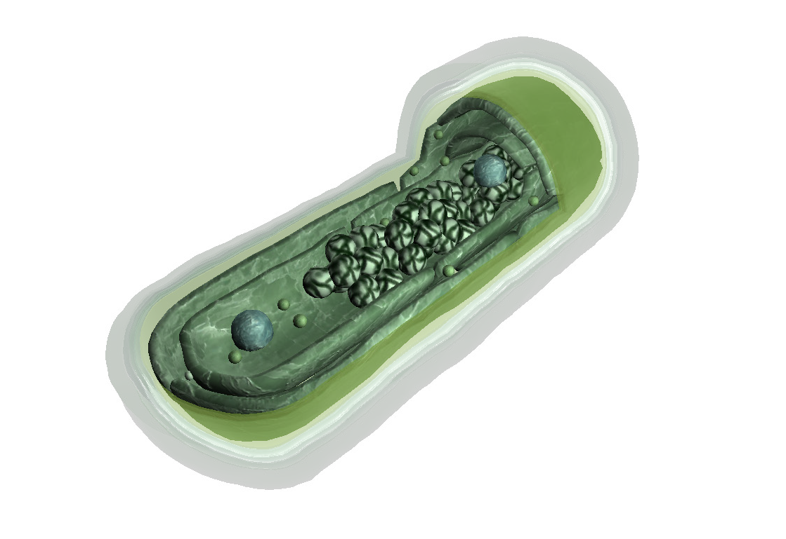
Restake Algorithm
Restake executes automatically and the rewards are auto-compounded on every epoch (6h). 90% of the rewards are being sent to Delegation ICA (restake) and 10% to the Fee ICA (Interchain Account)(the account where liquidity provider charges the fees)
epoch n: Queries Interchain Query (ICQ) to check balances of Withdraw ICA (where staking rewards are accumulated) and creates a new record for those tokens.
epoch n+1: Transfers tokens to Delegation ICA from the Withdraw ICA
epoch n+2: Stakes the tokens.
Rewards are automatically sent to the Withdrawal ICA.
WithdrawalBalanceCallback executes ICA SendTx with MsgSend to Delegation ICA (90% reward) and Fee ICA (10% reward). It also adds ReStakeCallback which triggers as previous ones, and in the correct path, it creates a new Deposit record with DELEGATION_QUEUE status (using WITHDRAWAL_ICA (contains cumulative staking rewards) source this time, not Archway source) while the buggy path is ignored.

Slide 15
Thank you

